Slide 1

FINANCIAL DATA ANALYSIS WITH SQL AND EXCEL

Slide 2
INTRODUCTION
This project aims to Demonstrate the Capabilities of SQL and EXCEL in financial data analysis,
From data extraction and manipulation to data visualization .
Tools Used: MYSQL workbench ,EXCEL, POWER POINT PRESENTATION

Slide 3

Financial Data Analysis
Data: Sales, Revenue, COGS, Profit
Dimensions: Country, Product, Date, DiscountBand
Metrics: UnitsSold, ManufacturingPrice, SalePrice, GrossSales, Discounts, Sales, COGS, Profit
Analysis Insights
Country-wise sales and profit
Product-wise sales and profit
Monthly and yearly sales trends
DiscountBand-wise sales and profit
Key Questions
Which country generates the highest sales?-
Which product has the highest profit margin?
How do sales trends vary by month and year?-
What is the impact of discounts on sales and profit?

Slide 4
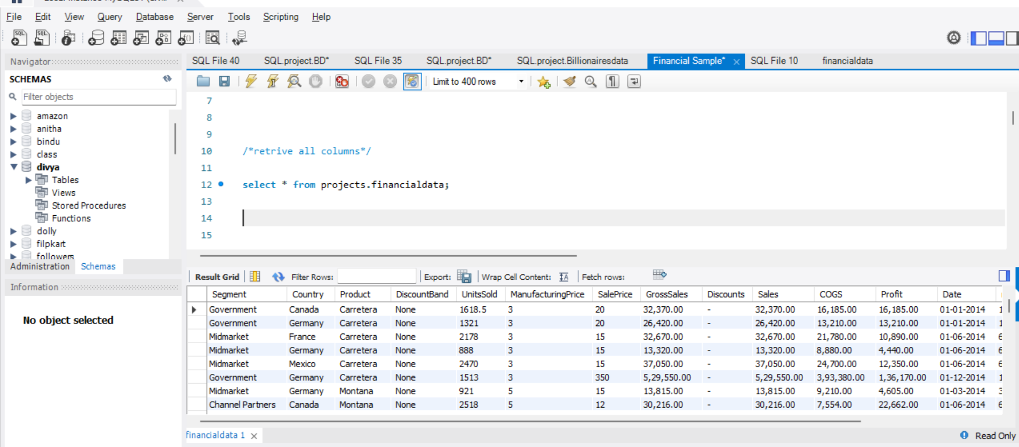
Retrieve all Columns
select * from projects.financialdata;

Slide 5
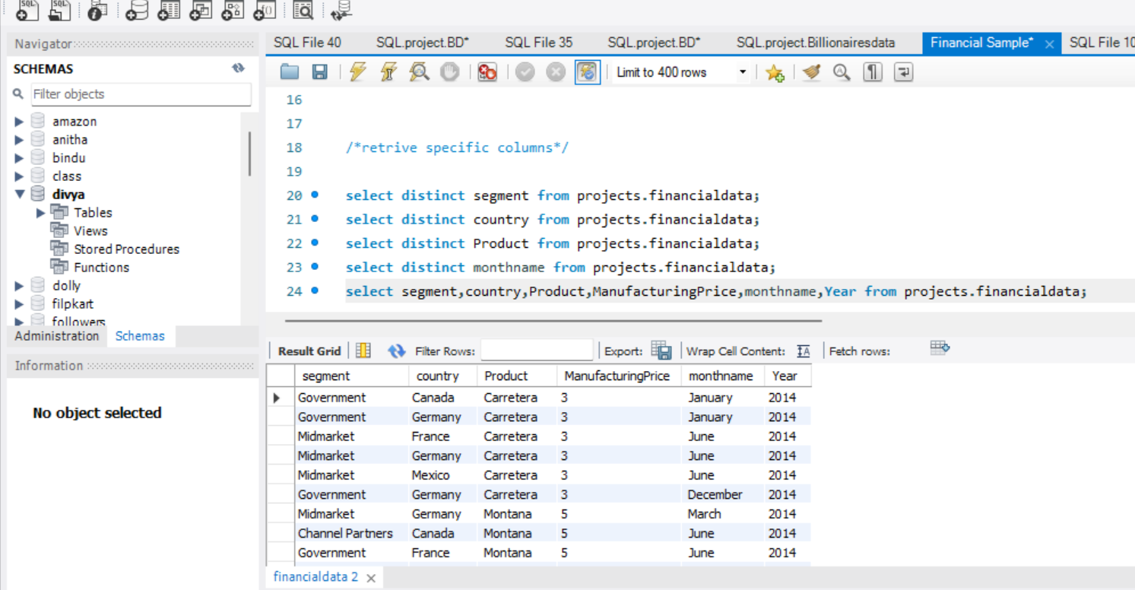
Retrieve specific columns
select distinct segment from projects.financialdata;
select distinct country from projects.financialdata;
select distinct Product from projects.financialdata;
select distinct monthname from projects.financialdata;
Selectsegment,country,Product,ManufacturingPrice,monthname,Year from projects.financialdata;

Slide 6
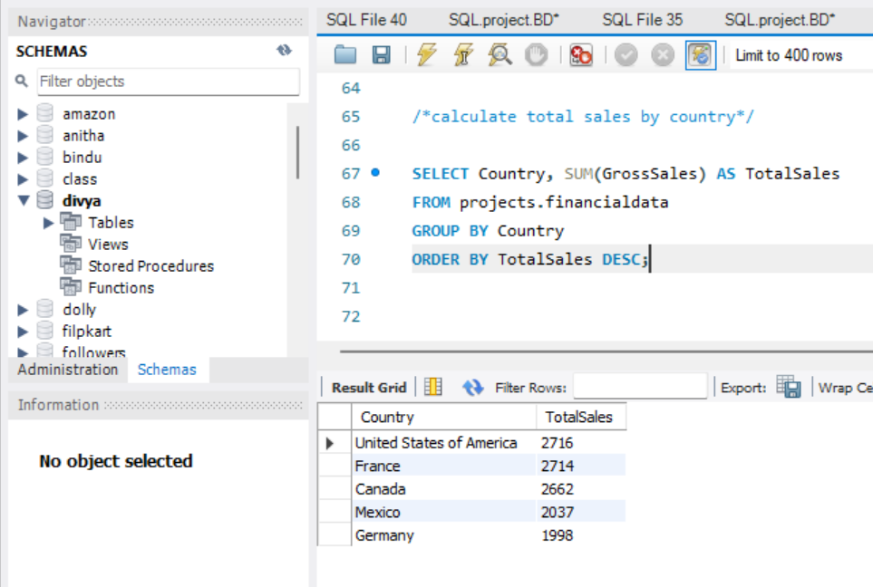
Calculate Total sales by country
SELECT Country, SUM(GrossSales)AS TotalSales
FROM projects.financialdata
GROUP BY Country
ORDER BY TotalSales DESC;

Slide 8
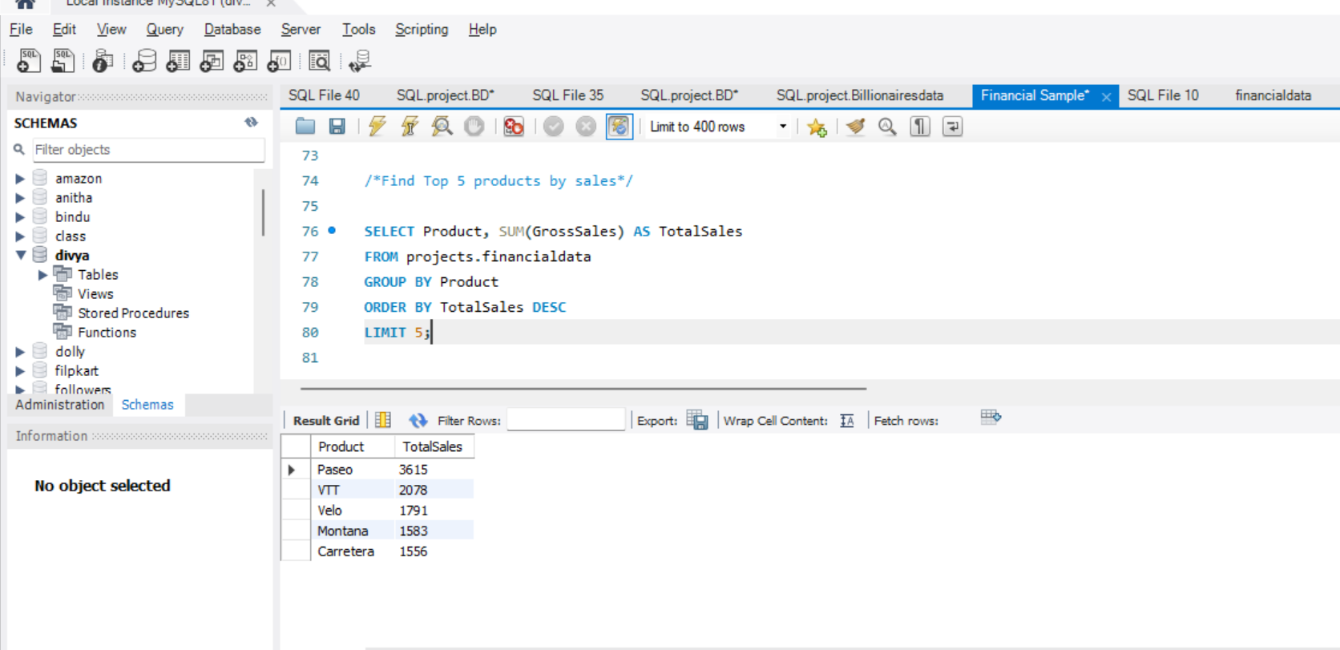
Top 5 products by sales
SELECT Product, SUM(GrossSales) AS TotalSales
FROM projects.financialdata
GROUP BY Product
ORDER BY TotalSales DESC
LIMIT 5;

Slide 10
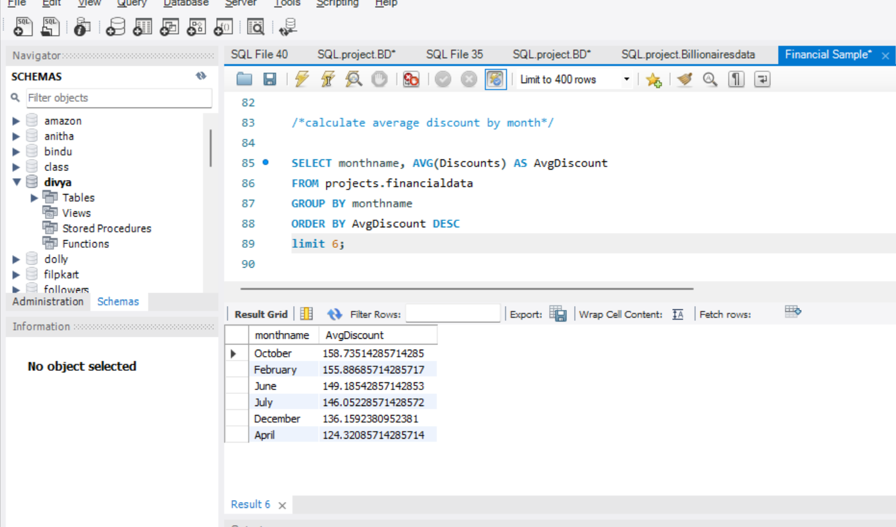
Average discount by Month
SELECT monthname, AVG(Discounts) AS AvgDiscount
FROM projects.financialdata
GROUP BY monthname
ORDER BY AvgDiscount DESC
limit 6;

Slide 12
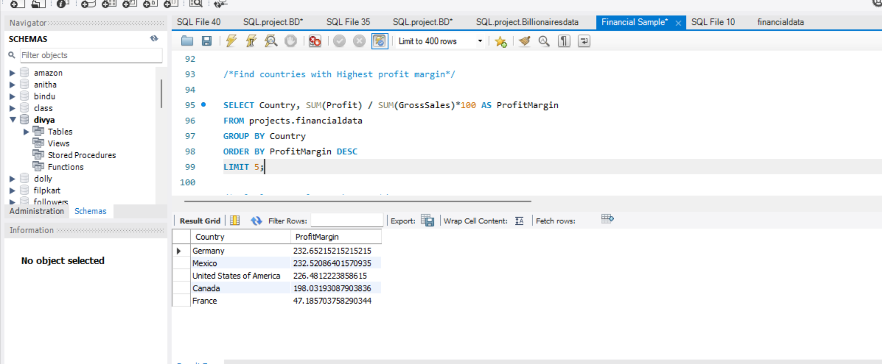
Countries with Highest profit margin
SELECT Country, SUM(Profit) / SUM(GrossSales)*100 AS ProfitMargin
FROM projects.financialdata
GROUP BY Country
ORDER BY ProfitMargin
DESCLIMIT 5;

Slide 14
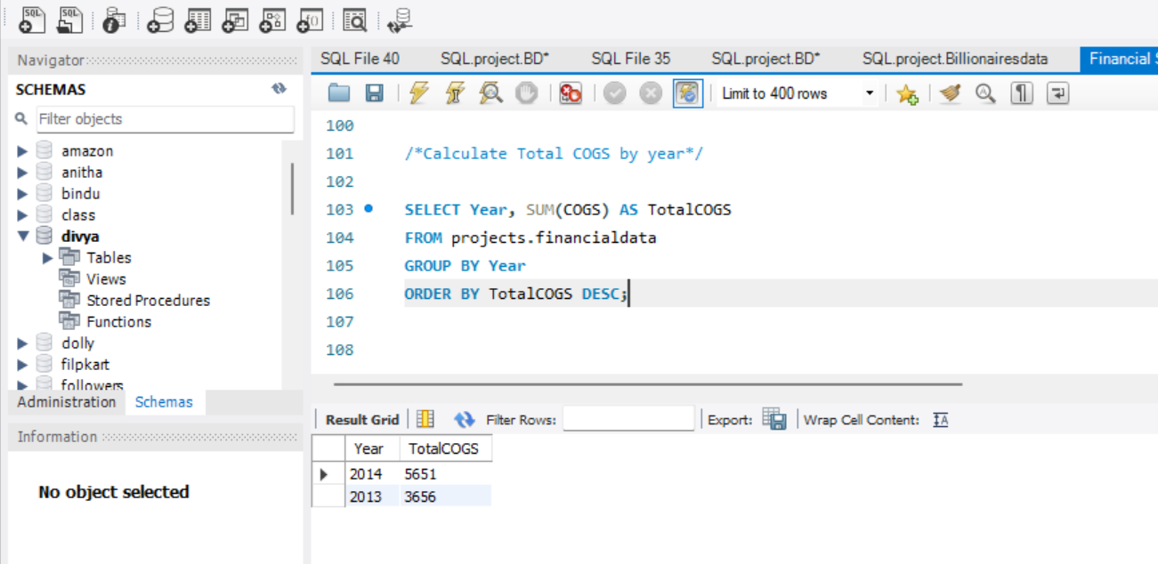
Cost of goods sold by year
SELECT Year, SUM(COGS) AS TotalCOGS
FROM projects.financialdata
GROUP BY Year
ORDER BY TotalCOGS
DESC;

Slide 16
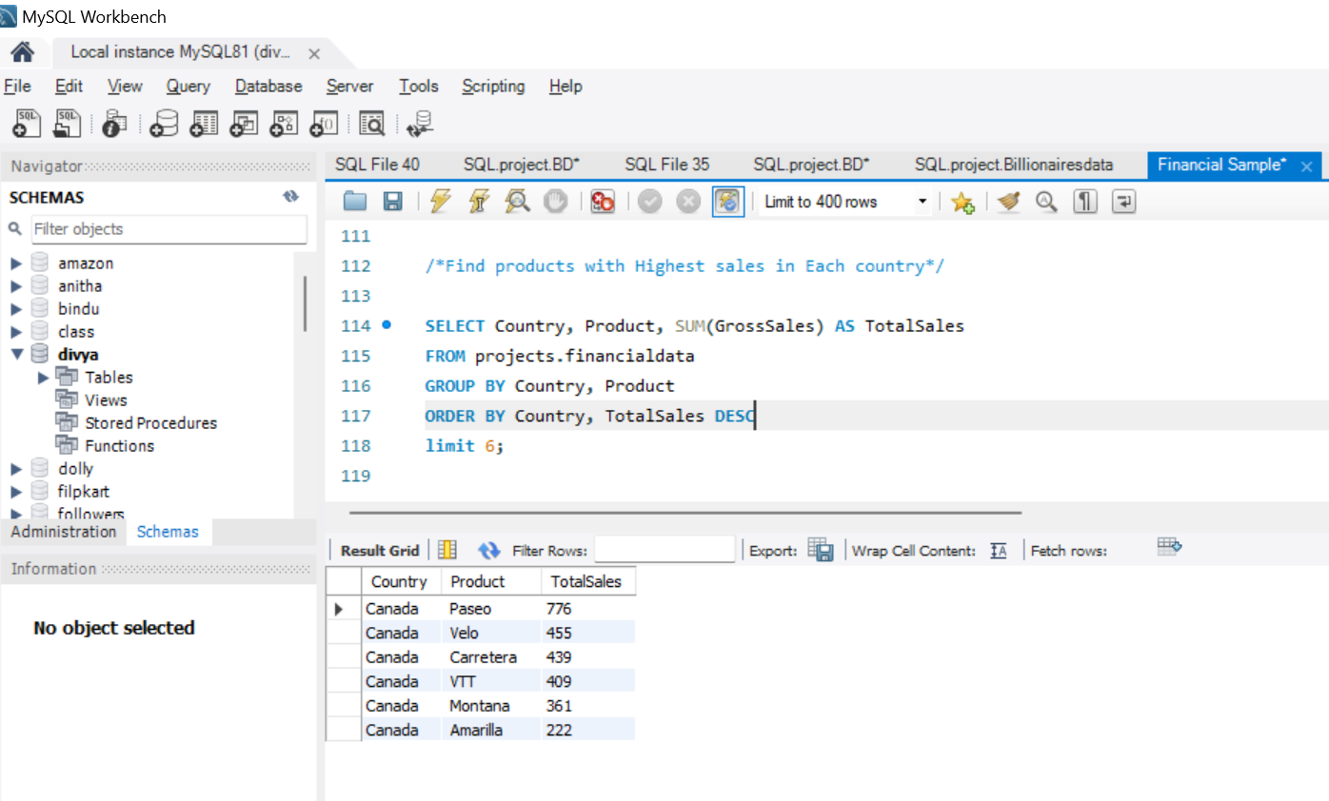
products with Highest sales in Each country
SELECT Country, Product, SUM(GrossSales) AS TotalSales
FROM projects.financialdata
GROUP BY Country, Product
ORDER BY Country, TotalSales DESC
limit 6;

Slide 18
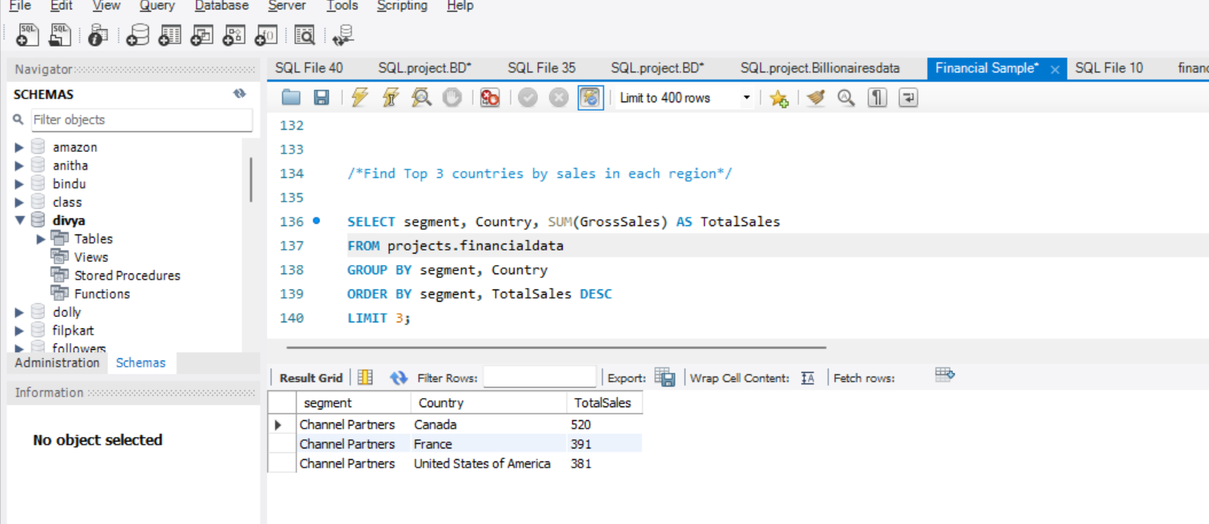
Countries by sales in each region
SELECT segment, Country, SUM(GrossSales) AS TotalSales
FROM projects.financialdata
GROUP BY segment,Country
ORDER BY segment, TotalSales DESC
LIMIT 3;

